Slide 1


Risk Management for Projects
Said Fawzy
Section 2:
Risk identification

Slide 2
Module Contents
Context and objectives
Why risk identification?
Case study: Western Savannah
Discussion: Risk identification techniques
FAQs

Slide 3
What you will learn in this section
Identify risks in achieving objectives
Identify categories of risk, and
Select methods to identify risks.

Slide 4
Before we start …. Problem Definition

Slide 5
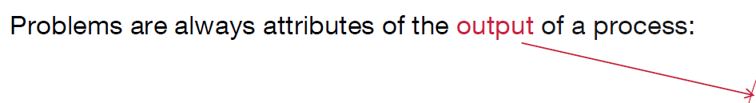
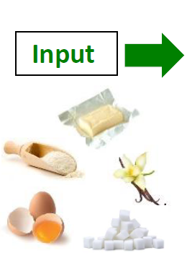
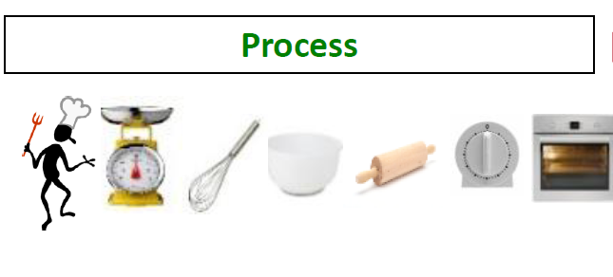
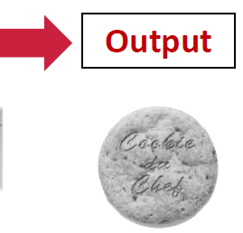
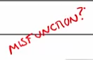


From Course: 6 Sigma definition
Customer complain of burnt cookies. So where is the problem ?

Slide 6
1:Context and objectives

Slide 7
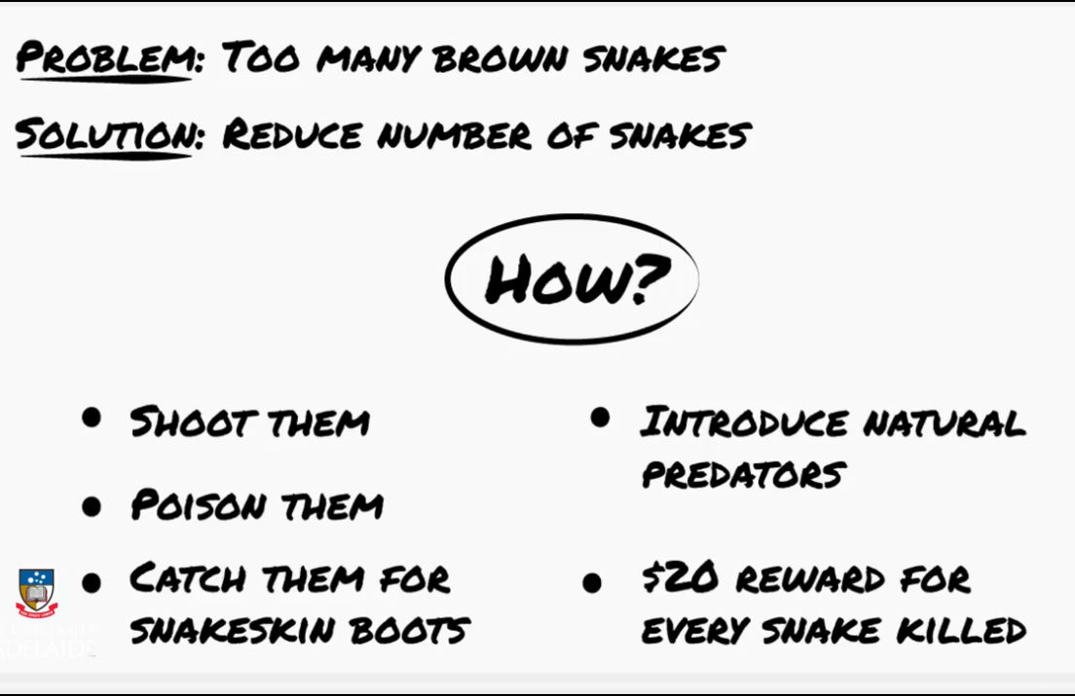
Context and objectives
Recall The brown snake story :

Slide 8
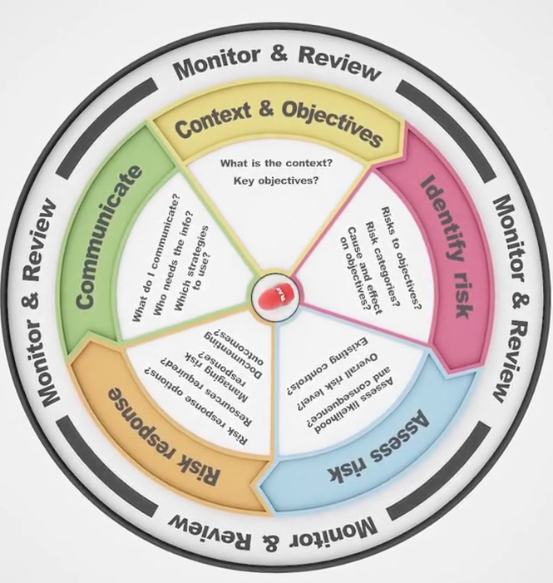
The risk management process starts with Context and Objectives.

Slide 9
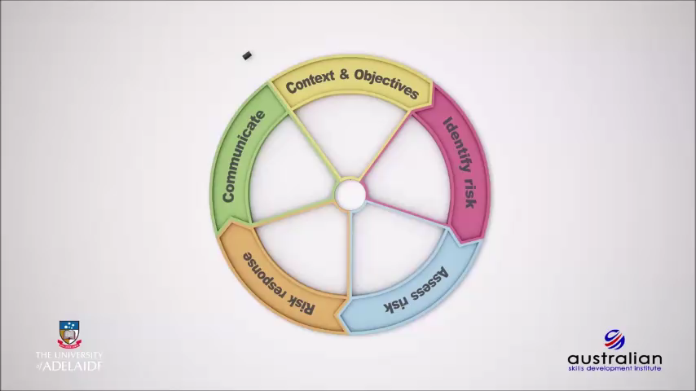

Slide 10
Context and objectives
Risk management is an integral part of project management.
the context and objectives of the project should align with the organization’s mission and vision.
Without having a clear understanding of exactly what it is you need to achieve, it is likely that any decisions made without the necessary clarity will likely have a negative impact on project outcomes.

Slide 11
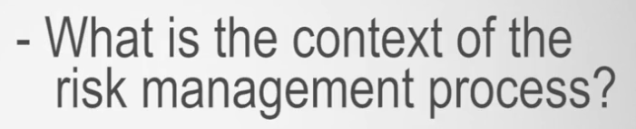
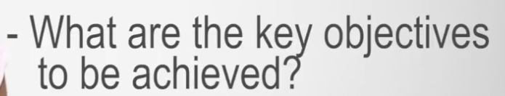
Key questions you need to address in this stage :

Slide 12
Context and objectives
The Context and Objectives stage sets the foundation for the rest of the risk management process.
Correctly setting these objectives will ensure that you will be in a position to
identify,
assess, and
respond to risks appropriately

Slide 13

Setting the context and objectives

Slide 14
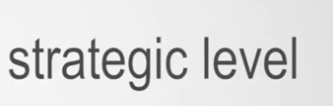

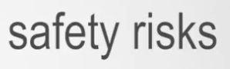
what does setting the context mean?
establishing the context is where formal determination or articulation is made as to where you propose to apply the risk management process.
Project Level
Our Course

Slide 15
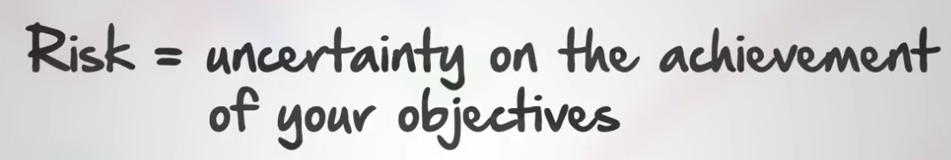
How to define objectives ?

Slide 16
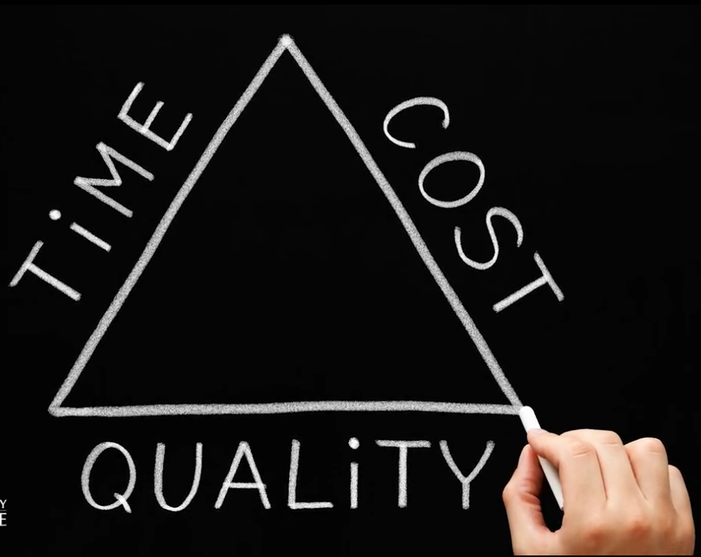
Project Objectives
Deliver project :
on time
Within budget
And
Of the right quality

Slide 17






Applying SMART Criteria
(Achievable)

Slide 18
How to Apply ?
Set your objectives of your project.
Review each objective and check SMART crateria.

Slide 19

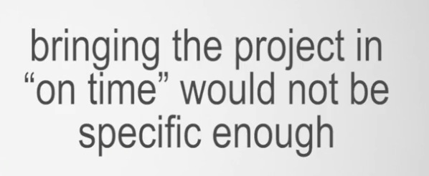

What do you mean by : “On Time” ?
Nominate the actual date of completion

Slide 20

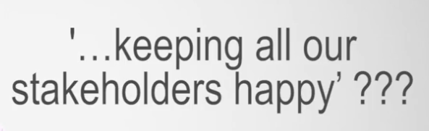

Create a measurement

Slide 21



Aligned with Organization’s overall Objectives

Slide 22


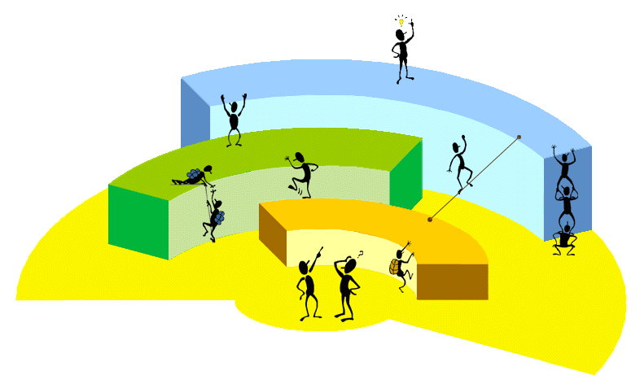
Objectives that are not realistic can not be met and result in project failure

Slide 23


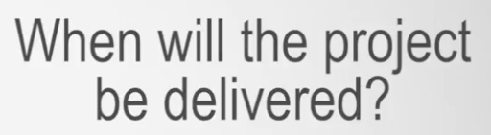

Slide 24
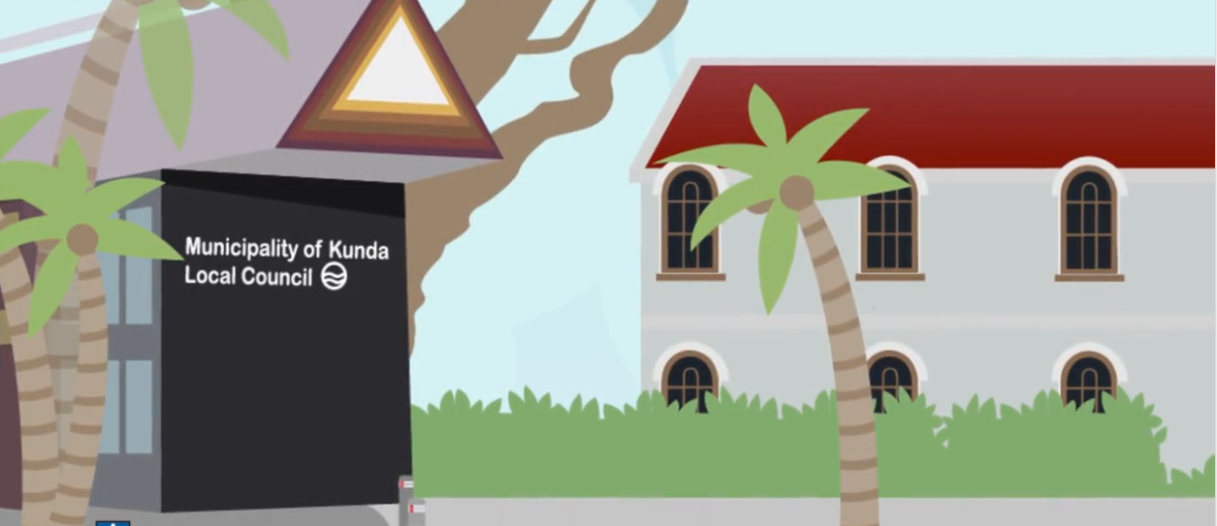
Returning to our Kunda Island council's brown snake scenario
is it possible to craft an objective that addresses the defined problem and also meets the SMART criteria?

Slide 25
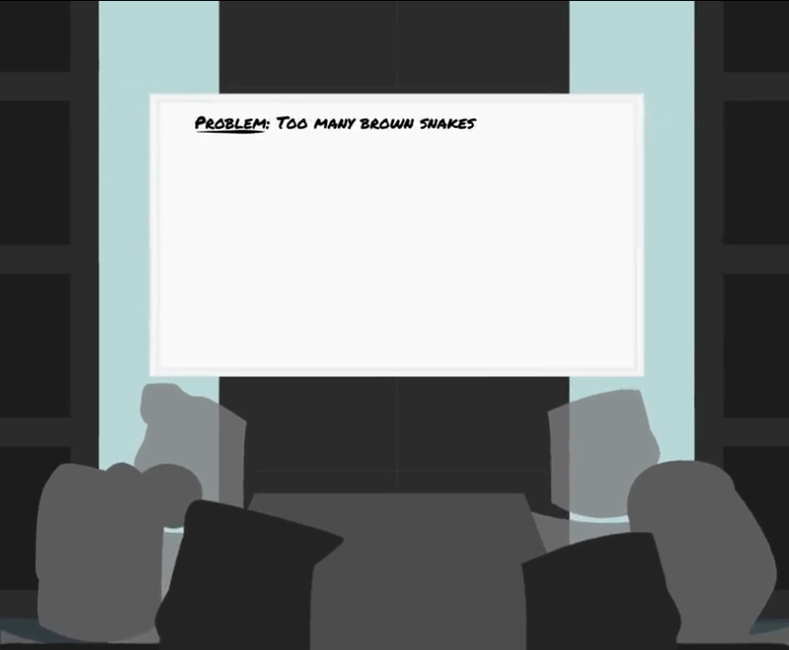
What is the Council problem ?
council is concerned over the increasing number of snakebite fatalities on the island.
Core Problem

Slide 26
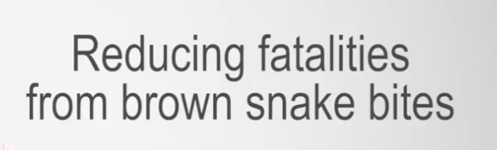
Let us put an objective
It is Ok ..why ?
1-Address the core Issue
2-Clear and specific objective

Slide 27
Is it OK now ???
Although specific, we need to add the remaining SMART filters to make this more robust,

Slide 28
What we need more?
we need to indicate what level of snake bite reduction we want to achieve in order for it to be measurable.
We need to consider whether the objective aligns with council policy
Whether the objective is realistic within the given time frame

Slide 29
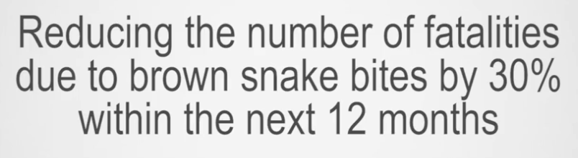
A smarter objective might now be set as:

Slide 30
The Kunda Island scenario: Clarifying objectives
Kunda Island (Part 2): Importance of clarifying project objectives

Slide 31
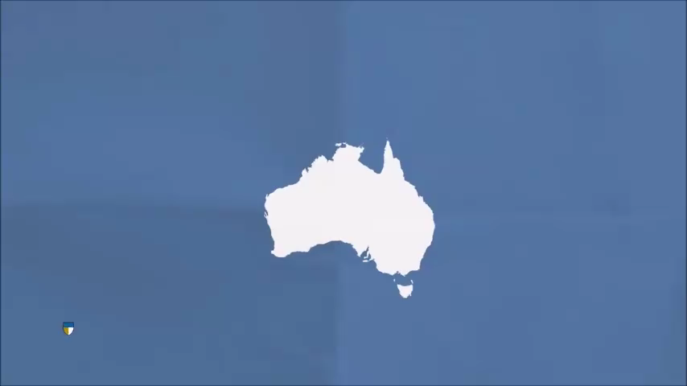

Slide 32
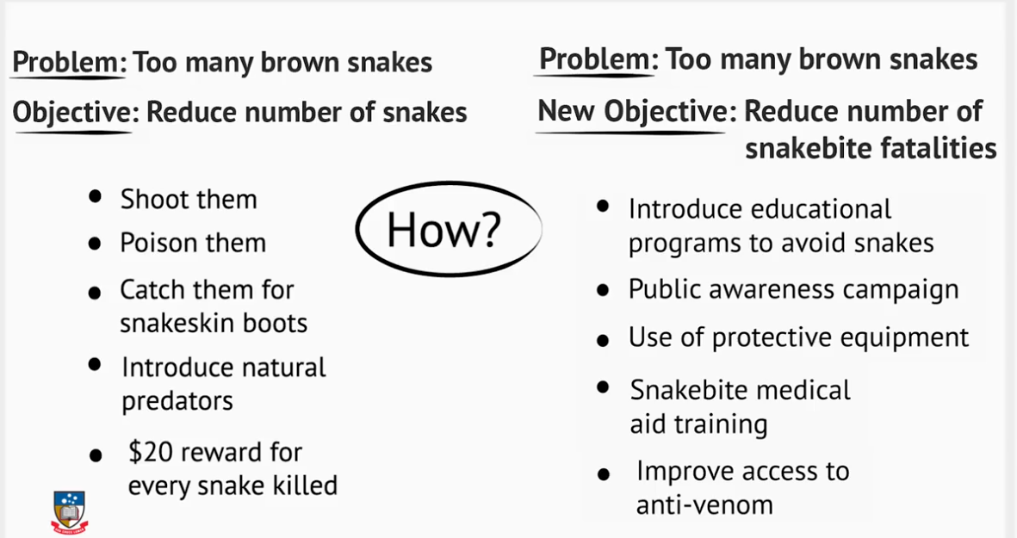

Slide 33
Knowledge check 1:
Risk identification

Slide 34

Question 1
What is established when the context and objectives are set?
The situation within which the project is delivered
The situation within which the risk management process takes place
The situation within which the risk identification takes place
The situation within which the project is executed

Slide 35
Question 2
The most effective technique to use in setting objectives for the risk management process is by using the SMART acronym. SMART stands for Specific, Measurable, Aligned, Realistic and Timebound.
Which of the following is an example of a SMART target for the Kunda Island scenario involving brown snakes?
Explanation
Reducing the number of snake bites in Kunda by 40% over 3 months is a SMART objective. It is specific in what it intends to achieve. It can be measured - the reduction is 40% - and it is aligned to the problem that has been determined in the area. It is realistic, and can be measured over a period of 3 months.
Reduce the number of snake bites in Kunda through education
Reduce the number of snake bites in Kunda within 3 months
Reduce the number of snake bites in Kunda by 40%
Reduce the number of snake bites in Kunda by 40% within 3 months

Slide 36
2:Why risk identification?

Slide 37
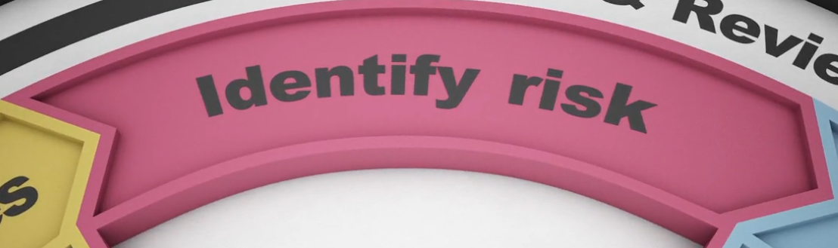
Risk Identification

Slide 38

Key questions in the risk identification stage

Slide 39
Risk identification in achieving objectives

Slide 40


Slide 41

Risk Identification :
The concept of risk identification may seem quite easy and straightforward
if this is rushed and a process is not followed in identifying risks for your project, it can contribute to lost opportunities or failure of the process as a whole

Slide 42
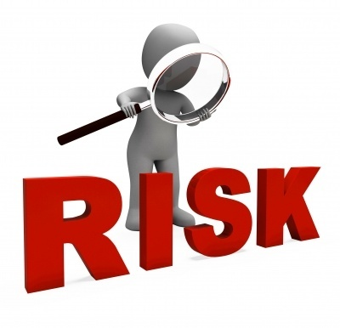
So what do we mean when we say that you need to identify risks for your project?

Slide 43

It is a systematic and detailed approach to ensuring that as many risks as possible are identified with the collaboration of stakeholders to ensure that they can be analyzed and responded to appropriately

Slide 44
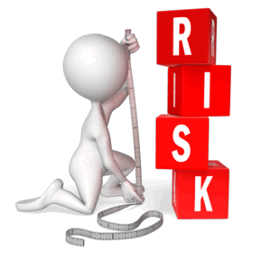
When identifying risk, you need provide a clear and in-depth description of the potential risk, and how it might impact on the project.

Slide 45

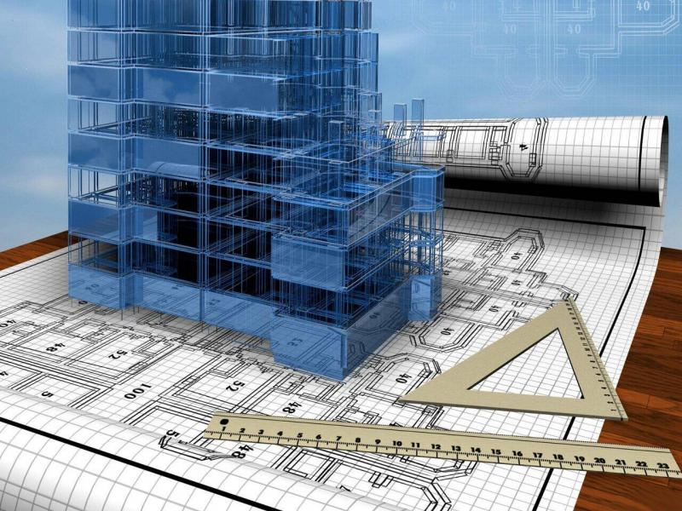
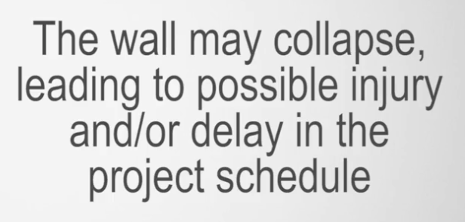
Example :
What is the difference ?

Slide 46
a statement
detailed description in terms of cause and effect relationship.

Slide 47

A key failing of project managers in risk identification is often the lack of description in terms of the cause-effect linkage.

Slide 48

How to identify risk ?

Slide 49
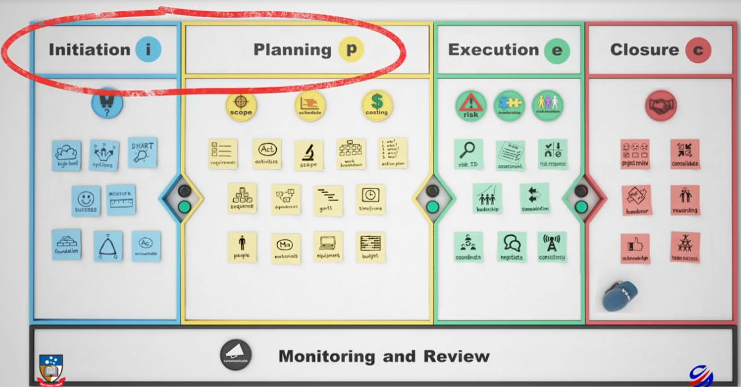
Risks needs to be identified in the early phases of the project

Slide 50
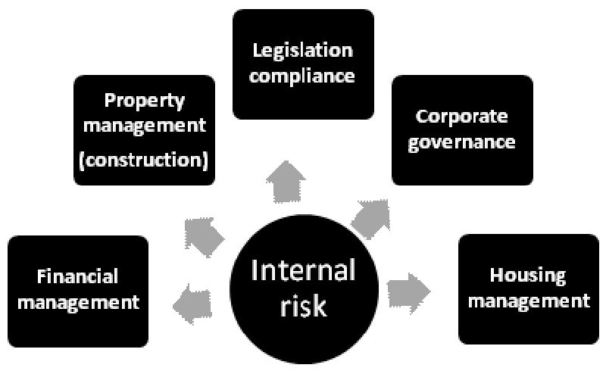
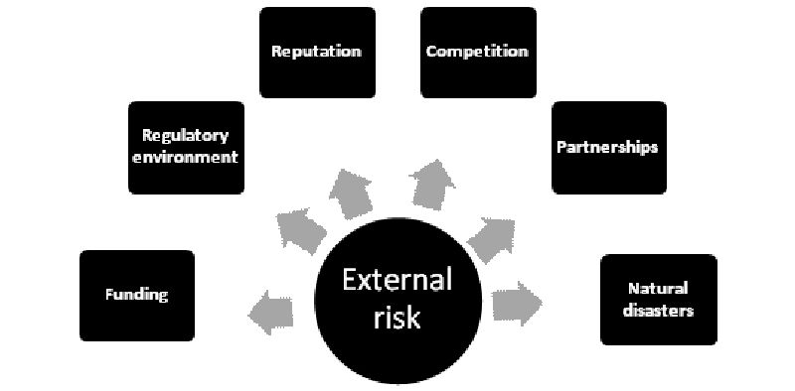
it is important that you not only identify all of the potential risks, but the sources of the risks as well

Slide 51


Example :
A potential risk
the building plans have not been approved, and this will delay the commencement of the project.
Risk Source
Architect
their responsibility to ensure that plans are submitted and approved by the necessary authorities prior to construction commencing

Slide 52

So where do we get information regarding the potential risks of a project?

Slide 53


Slide 54
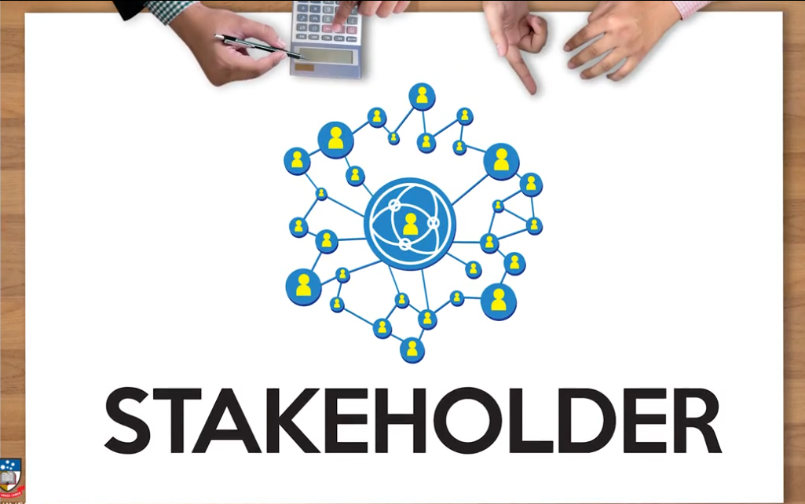
a good strategy is to draw on all key internal and external stakeholders, and obtain information from them as well as possible solutions to the risk.

Slide 55
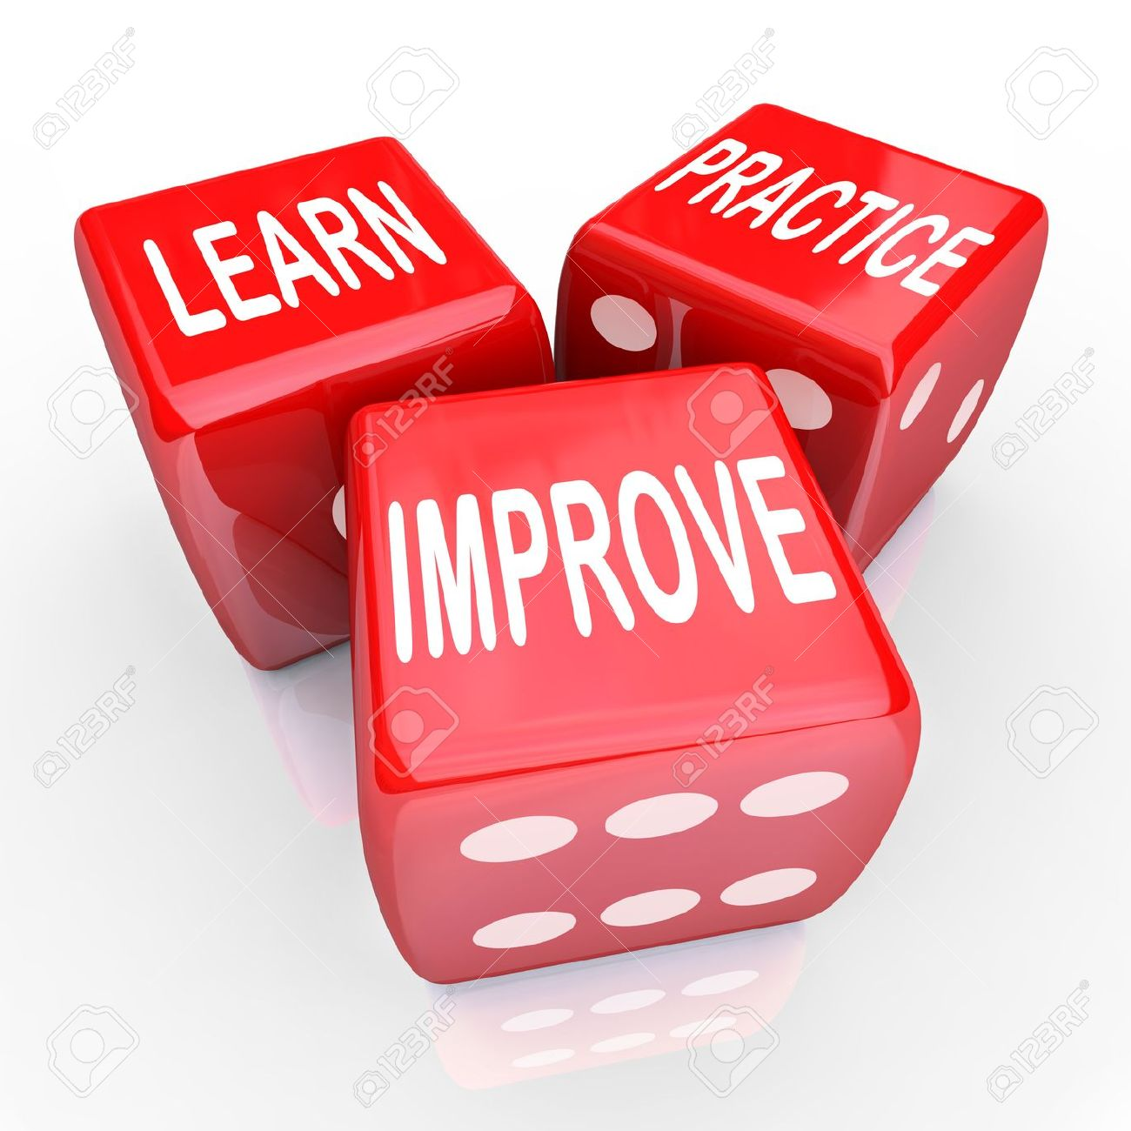
Risk identification is a skill that improves through experience and practice

Slide 56

allow sufficient time to engage with a range of people with a view to gain their insights and benefit from their learning experiences into uncovering potential risk areas in your project

Slide 57
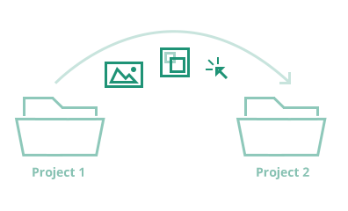
It is also possible to predict a risk based on experience from similar projects
Always remember that no two projects are exactly the same

Slide 58

risks aren't always immediately apparent

Slide 59

And so:
risk identification is a continuous
monitoring activity

Slide 60
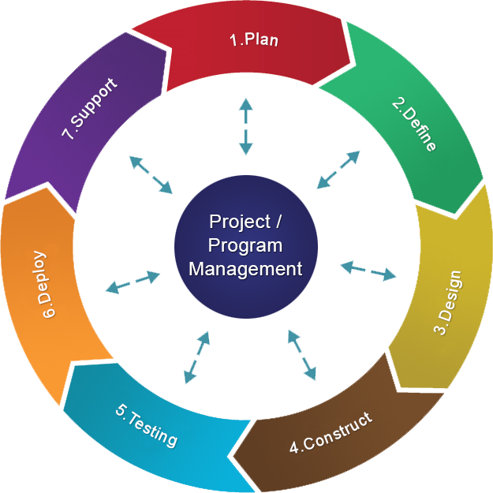
review of risks should take place throughout all stages of the project lifecycle.

Slide 61
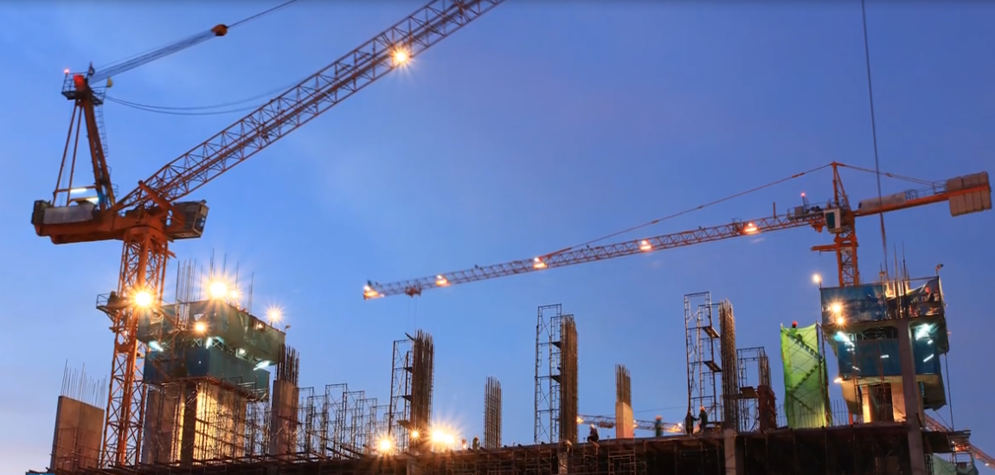
Categories of risk identification
To assist with this activity, it may be useful to use a categorization tool to ensure that you consider and capture various categories of risk.
Risk categories should reflect common types or sources of risk within a project, industry, or application area, and should be used during the risk identification discussion.

Slide 62







PESTEL

Slide 63
Example of Risk Discussion :
Do we think we have any political risks? Let’s look at our project through the political lens and see if we can identify these types of risks.
Next, we asked the same question of economics, and risks that may impact the economics of the project.

Slide 64


tax policy, trade restrictions, employment laws, and political stability.

Slide 65
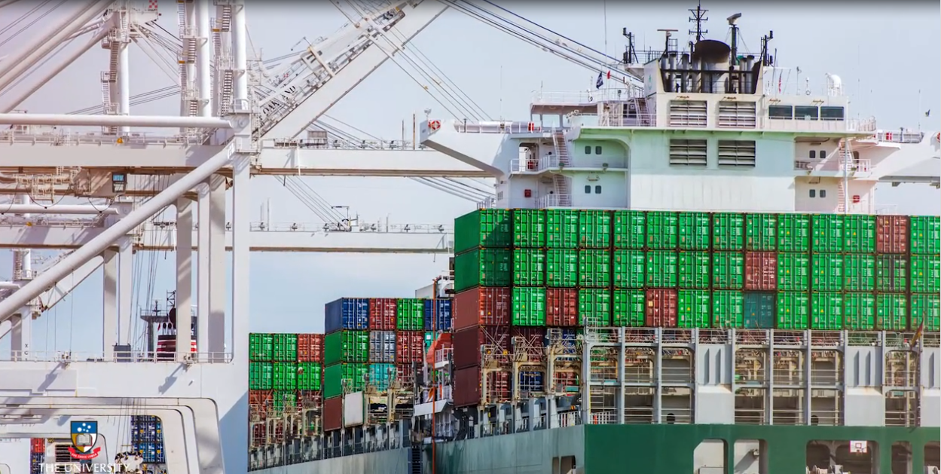
Example
your project is reliant on the importation of goods, and trade restrictions are subsequently imposed, this will present a significant risk that will need to be responded to

Slide 66

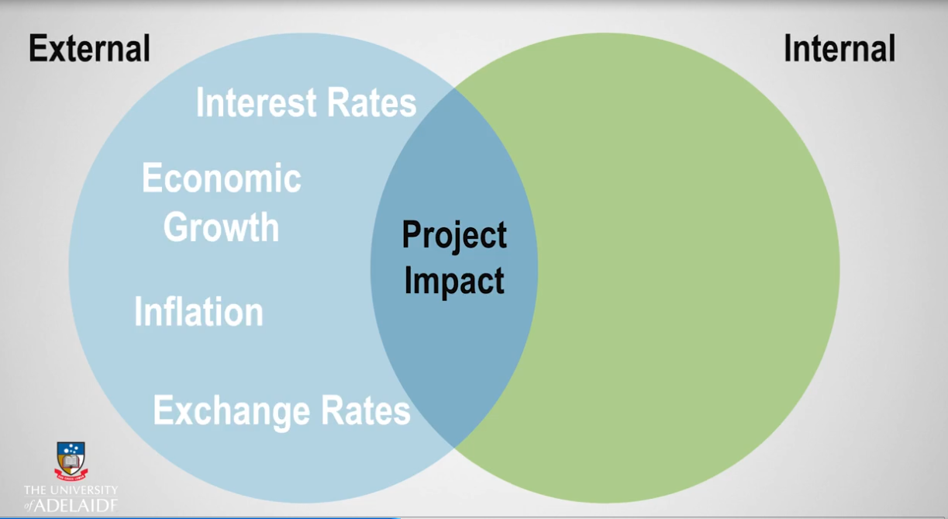

Slide 67
External economic factors:
Economic factors could change over the life cycle of a project .
These changes represent a risk and need to be managed and responded to as they come up

Slide 68
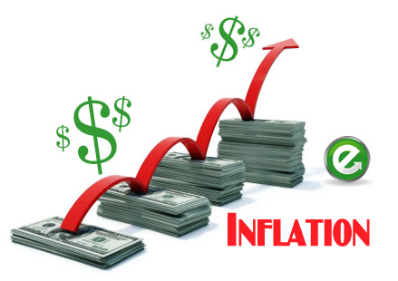
Example
Inflation may require a project manager to re-look the pricing of resourcing and contracting.

Slide 69

Example
Inflation can also force a business to increase prices of products which the market cannot absorb.

Slide 70
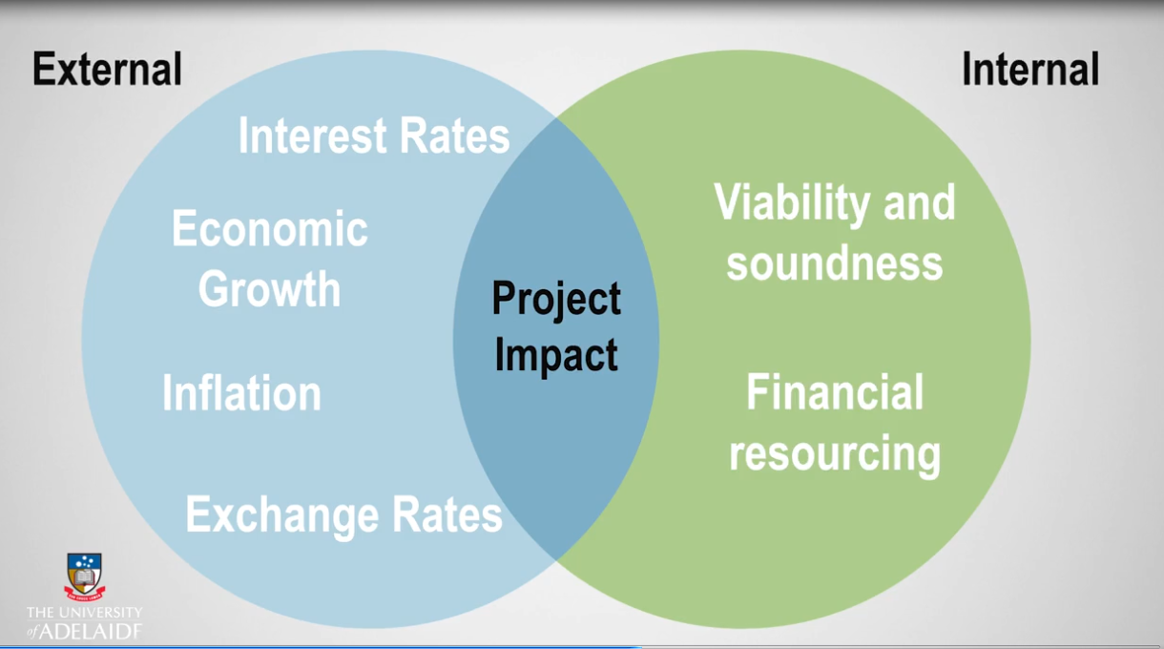

Slide 71
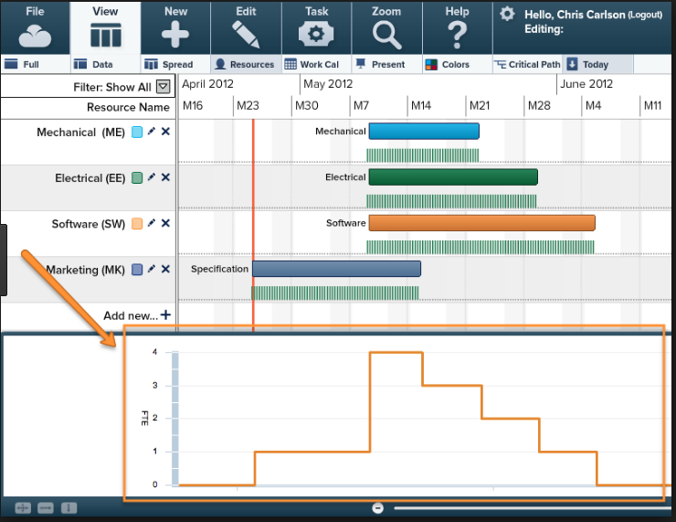
Example
has the project manager appropriately considered all the resources required to ensure successful execution of the project?

Slide 72


Social factors refer to the social or cultural environment in which the project is executed.

Slide 73

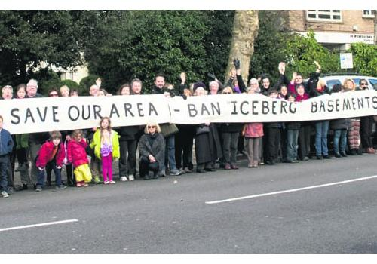
Example
A project in a conservation area

Slide 74


include all those activities affected by new technology or the access to technology.
It is important to adapt and keep up to date with technology in order to avoid any negative impacts on the project .

Slide 75

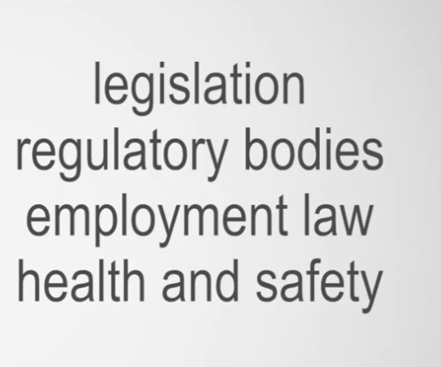
Changes in any of the legal factors, or failure to adhere to the law, will put the project at significant risk with severe consequences.
The only way to deal with legal factors is to remain compliant at all costs.

Slide 76

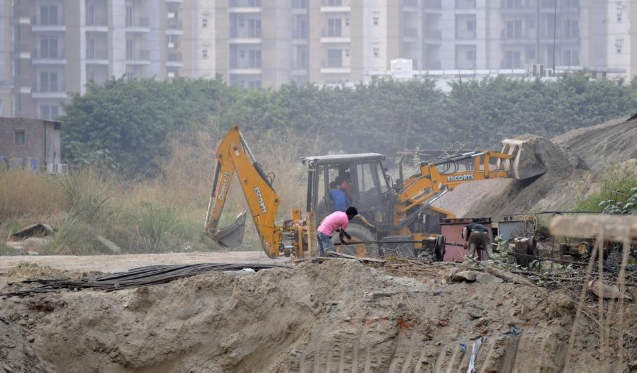
Adverse weather,
laws regarding pollution
recycling, use of green
eco-friendly products
sustainability.
. Governments are penalizing businesses for polluting

Slide 77
Conclusion :
Identifying risks, and potential risks, is key to effective risk management.
This step cannot be bypassed or done at a later stage of the project.
Although we have outlined PESTLE as main risk categories, there may be other categories that you and your project stakeholders would like to add that are specific to your project or industry.

Slide 78
Knowledge check 2:
Risk identification

Slide 79
Question 3
Which of the following is an example of a legal risk? Identify each legal risk.
Tax policies
Trade restrictions
Health and safety
Employment laws
Explanation
Legal risks arise from failure to comply with regulatory obligations, which need to be adhered to in any organization or project, regardless of the industry.

Slide 80
Question 4
True or false? An economic risk only refers to the external economic factors that might create risk for an organisation or project.
TRUE
FALSE
Explanation
Economic risk refers to the external and internal economic risk that may affect your project or organisation.

Slide 81
Question 5
Which of the following is considered a social risk? Identify each social risk.
Culture
Demography
Wealth
Sustainability
Explanation
Social risk refers to the social or cultural environment in which the project is executed, or in which the business operates. Sustainability is an environmental factor.

Slide 82
Question 6
Which of the following pairs is considered an external economic risk?
Project viability and inflation rates
Inflation rates and recession
Financial resources and credit available
Project viability and exchange rates
Explanation
These are factors that cannot be changed or controlled by the project manager.

Slide 83

Select and use methods to identify risks
Identifying Risks could have been a bit overwhelming.
Sometimes it's an issue of not knowing where to begin.

Slide 84


First Step :
What information you should collect ???
Information about :
your project,
the industry within which your project resides,
stakeholders,
resources, and
contractors

Slide 85
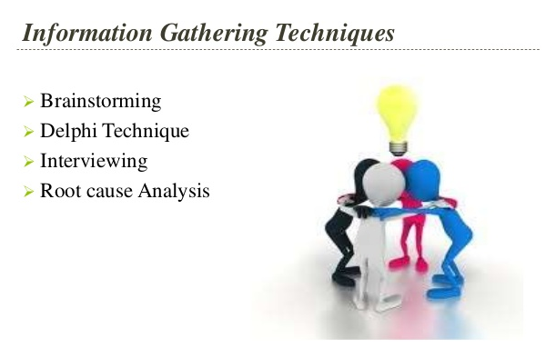

Slide 86




First Step :
How to get information ????

Slide 87

You have information. What is next ?

Slide 88

Brainstorming :

Slide 89

What is The objective of brainstorming ?
To generate a comprehensive list of possible risks that will be addressed later in risk analysis and assessment processes

Slide 90

Brainstorming :
Identifying any risk at this point, even if it seems unnecessary or irrelevant.
PESTLE can be most beneficial.

Slide 91

Brainstorming :
sources of risk are identified and posted for all to examine during a meeting.
Risk descriptions in terms of cause and effect need to be sharpened.

Slide 92
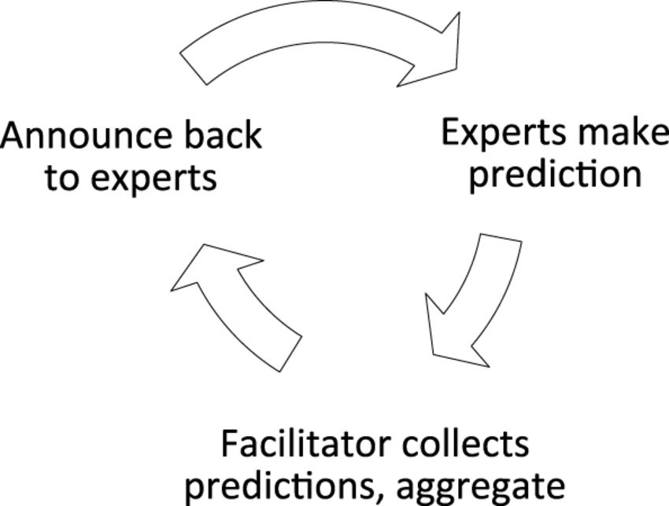
Delphi Technique :
is a way to reach consensus through the use of experts on a particular subject area.
Helps reduce bias in the data and keeps any person from having undue influence on the outcome

Slide 93
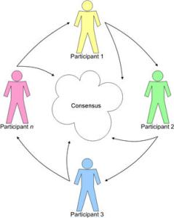
Delphi Technique :

Slide 94






Expert1
3
Send problem
Expert2
Collect Result
Facilitator
Expert4
Summaries and start new Iteration

Slide 95
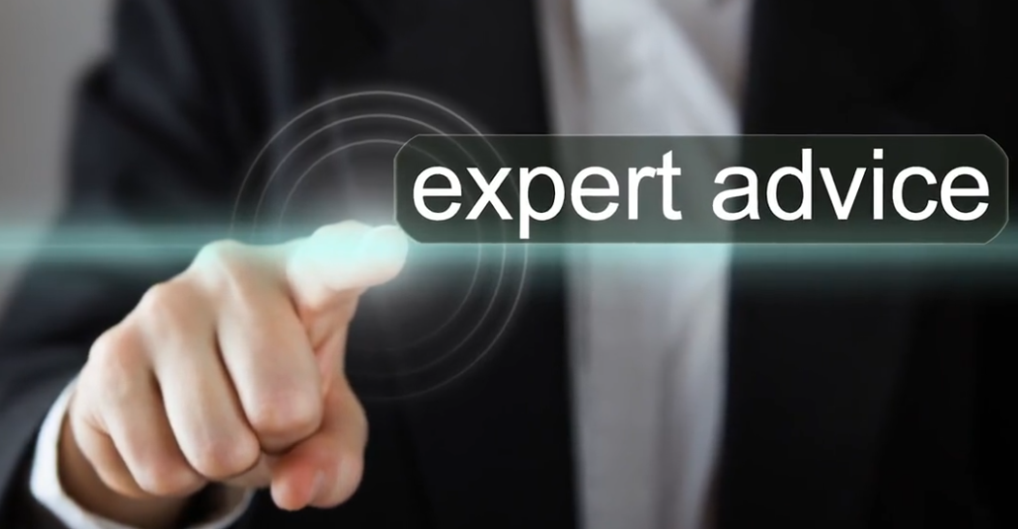
Expert Advice :
As the project manager, you might meet with appropriate individuals and provide information, including the work breakdown structure and the list of assumptions.
The interviewees identify risks they may see on the project documents based on their own experience.

Slide 96
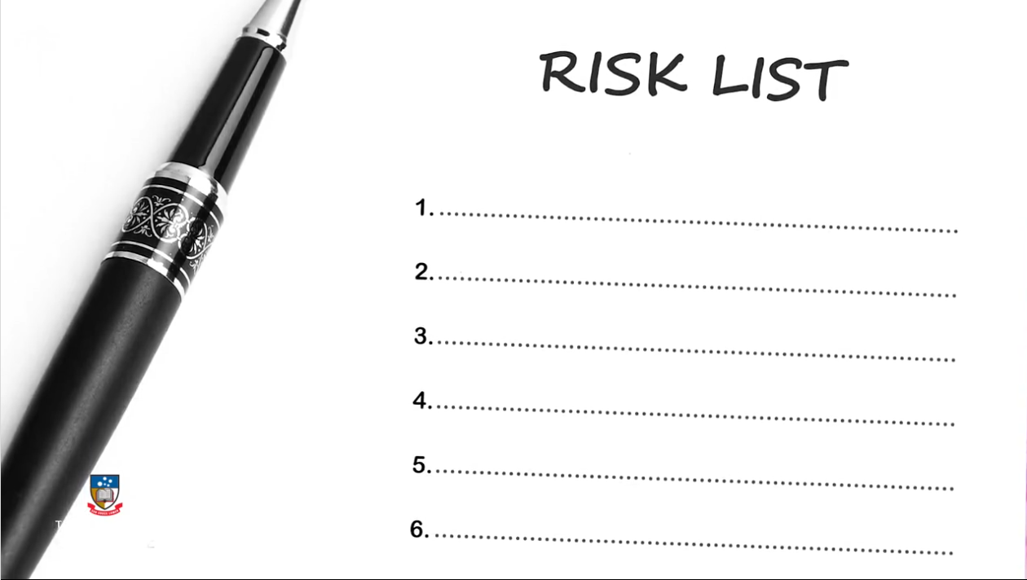
Risk List
can be developed based on historical information and knowledge that has been accumulated from similar previous projects.

Slide 97

Advantage and Disadvantage of Checklists :
Advantage is quick and simple.
Disadvantage is:
that it is impossible to build an exhaustive checklist of risks
the user may effectively be limited to the categories in the list.

Slide 98

Checklist
The checklist should itemize all types of possible risk to the project.
It is important to review the checklist as a formal step of every project closing procedure to improve the list of potential risks and to improve the description of those risks.

Slide 99
Diagraming Tanique :

Slide 100

Fishbone Diagram (Ishikawa Diagrams)
Also Known as Cause and Effect Diagram

Slide 101

Process flowchart
Enables project managers to show how various elements of a system or project interrelate to one another.

Slide 102

Decision Tree :

Slide 103
Solve a Decision Tree Problem

Slide 104

Influence Diagram (Decision Diagram)
Is a graphical representation of a problem showing causal influences, time ordering of events, and other relationships among variables and outcomes.

Slide 105
Knowledge check 3:
Risk identification

Slide 106
Question 7
What is the first step you should take when identifying risks?
Information gathering
Stakeholders meeting
Project Team meeting
Brainstorming
Explanation
Information gathering includes conducting research into the project, stakeholders, industry resources, and any contractors you may be working with on the project.

Slide 107
Question 8
A comprehensive list of risks should be identified before they are categorised. One of the best methods to use is brainstorming.
Who should be part of the brainstorming process of identifying risks?
Project manager, stakeholders, project team, risk manager
Project manager, risk manager, project sponsor, contractors
Project sponsor, project manager, project team, risk manager
Project sponsor, project manager, risk manager, stakeholder
Explanation
Any process undertaken to identify risks should include the project manager, stakeholders, project team and risk manager. Remember, in some cases the project manager and the risk manager are the same person.

Slide 108
Question 9
Which of the following combinations of methods would be useful in identifying risks?
Checklists, diagrams, interviews, Delphi technique
Pie charts, checklists, Delphi techniques, interviews
Checklists, diagrams, facilitator, interviews
Pie charts, facilitator, Delphi technique, diagram
Explanation
There are a variety of methods and techniques that can be used to identify risks. Checklists, diagrams, interviews and the Delphi technique are some of the most common. A pie chart is not a method to identify risks.

Slide 109
3:Case study:
Western Savannah

Slide 110
YOUR INSTRUCTIONS
Step 1: Read the email from Geoff Thompson, CEO of Oasis Construction Step 2: Read Appendix A: The asset/infrastructure requirements Step 3: Read Appendix B: Site visit report Step 4: Fill in the PESTLE framework with identified risks
Note: The identified risks in the Western Savannah case study will be referred to throughout the course.

Slide 111
Step 1: Email from Geoff Thompson
From: Geoff Thompson <geoff.thompson@oasis.com> CEO Oasis Construction, Texas Head Office Sent: Monday, July 20, 2017 10.37 AMTo: You <you@oasis.com> Project Manager, Budget Hotel Construction DivisionSubject: Confidential – Western Savannah Luxury Hotel Project (Australia)Importance: High

Slide 112
………
Hi,
With a view to expand our portfolio internationally, we submitted a tender to the Western Australian state government to develop a high quality eco-hotel in a remote northern region of the state called the Kimberley.
The aim of the government is to develop and expand high-value tourism across remote areas of the state. I have just received notification that our company was awarded the construction contract by the Western Australian government.

Slide 113
………
The executive team here at Oasis Construction has acknowledged the successes of your past projects, and as such we would like to offer you the role of project manager on this project. Although this assignment is very different to your usual role of managing our three-star budget traveller hotel construction projects in Texas, the Board has decided to expand Oasis’s offshore activities. We have full confidence in your ability to manage and oversee this project successfully.

Slide 114
The brief:
We have been informed that the hotel will have functional and luxurious elements catering to a wider variety of tourists visiting the region. The core hotel development will consist of 40 rooms including private swimming pools and other five star facilities like an eco-spa. The construction of the hotel would be used to showcase the natural spectacle of the region without disrupting the natural ecosystem, with a focus on sustainable materials. Due to regulatory requirements, the hotel cannot exceed one level in height and should be constructed using sustainable materials that will not visually impact the natural scenery of the region. Specifications include rooms blended into the rocky gorges, and include the fitting of glass ceilings to give full access to the magnificent starlit canopy at night.

Slide 115
The Kimberley is a sparsely settled northern region known for vast wilderness demarcated by rugged ranges, dramatic gorges, and semi-arid savannah. The Gibb River Road runs 700 kilometres through the heart of the region, passing through several national parks, some of which have towering limestone cliffs and rock pools where freshwater crocodiles gather. This region has become a popular tourist attraction in Australia, despite the remoteness of the region.

Slide 116
Your first activity is to undertake an early stage risk assessment for the project. The Board has requested that you develop a high-level risk register to present at their next meeting in 4 weeks. To assist you in this assignment, please find attached:
Appendix A: Overview of infrastructure/assets to be constructed
Appendix B: Some observations made during a pre-tender site visit conducted by our Business Opportunity Manager.
Best regards,
Geoff Thompson CEO: Oasis Construction 25 Millbend Road, The Woodlands, Texas, 75201 e: geoff.thompson@oasis.com

Slide 117
Step 2: Appendix A: The asset/infrastructure requirements
40 free-standing eco-friendly accommodation units built to high-detail specification. The total cost of the project is estimated to be AUD$90 million dollars, and is to be completed over a 2-year period
Gym and spa facilities and 40 private plunge/swimming pools
7 viewsites to optimise views around the gorge areas
Provision of utilities - water, sewerage, electricity, internet, and telecommunications - and associated infrastructure

Slide 118
Step 2: Appendix A: The asset/infrastructure requirements…cont
Fire and emergency facilities at the storage facility and residential areas (permanent and temporary)
A temporary contractors' camp of 20 pre-fabricated units on site for temporary housing but with potential for expansion
Contractors offices and associated services
Mini health/medical clinic at the nearby town, and
Other associated minor buildings such as a recreation room, small gym, food store.

Slide 119
Step 3: Appendix B: Site visit report

Slide 120


Slide 121


Slide 122


Slide 123


Slide 124


Slide 125


Slide 126


Slide 127


Slide 128


Slide 129


Slide 130


Slide 131


Slide 132


Slide 133


Slide 134


Slide 135


Slide 136
Step 4: PESTLE framework
Risks identified
Now that you have a thorough understanding of the Western Savannah project, use this PESTLE framework to categorise each of the identified risks. Type each identified risk into the corresponding part of the framework.

Slide 137


Slide 138


Slide 139


Slide 140
Suggestion for Answer

Slide 141


Slide 142


Slide 143
Knowledge check 4:
Risk identification

Slide 144
Question 10
A tool that can be used to identify risks is PESTLE. Select the option that correctly identifies each letter of PESTLE
Political, Economic, Social, Technological, Legal,Environment
Political, Economic, Schedule, Technological, Legal,Environment
Political, Economic, Stakeholder, Technological,Legal,Environment
Political, Economic, Scientific, Technological, Legal, Environment
Explanation
Remember that PESTLE is only one of several tools that can be used to identify risks.

Slide 145
4:Discussion:
Risk identification techniques

Slide 146
Discuss your risk identification techniques
In this part of the course, we would like you to share your experience in risk identification techniques that you have either used or seen used (that is, used by someone else) in a project or organization.
What techniques did you use to identify risks? How effective would you say the techniques were?

Slide 147
5 FAQ

Slide 148
FAQ:
"Who is responsible for identifying risks?"

Slide 149
FAQ:
Are there any documentation needs to be completed when identifying risks?

Slide 150
FAQ:
"Are there any risk identification tools that I can use to help me in a large project?"

Slide 151
Feed back

